Slide 1
In Partnership with:
Notes:
Welcome to a short presentation get you up to date on Operation Eyesight projects- past and future!. We thought you’d like to hear what we have been up to and most importantly how your support is making a huge difference in many people’s lives!

Slide 2
Nepal :Vision on Wheels
Mobile Eye Clinic
Serves 100,000 people in hard to reach areas
Project now officially complete
Expected to conduct 400 surgeries per year
Notes:
Our Vision on Wheels project in Nepal is now complete. This project provides a mobile clinic to screen underserved populations. We expect to test up to 100,000 people per year and conduct 400 surgeries. While the Covid 19 pandemic has slowed the roll out of this program it is now gearing up for full operation.

Slide 3
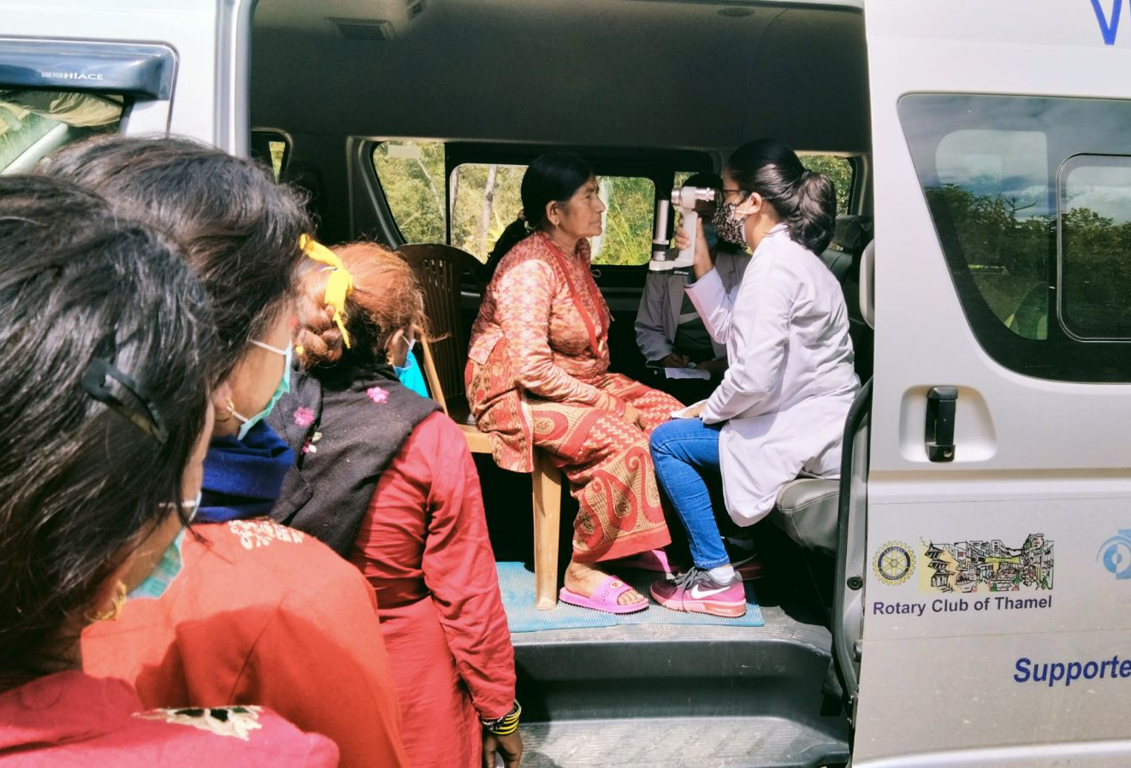
Notes:
The mobile clinic has all of the capability of a vision centre with optical screening taking place right in the vehicle.

Slide 4
GG 2123221 Mzuzu Eye Health
Project based in Mzuzu, Malawi Africa
Project cost $69,138 US with
$ 35,148US from RCNS – OEU restricted account
$ 3,990US from RC Simcoe
$ 15,000US from District 7090,
$ 15,000US from Rotary International
Notes:
Our current project is in the southern Africa county of Malawi. Allow with our successful fundraising campaign last year, project funding comes from our partner club RC of Simcoe as well as Rotary District 7090 funding and funding from Rotary International!

Slide 5
Mzuzu Eye Health
Optical equipment for surgical suite
Optical supplies and equipment for surgery
Provide optical training for nurses
Provide training for maintenance staff
Budget changed to provide new vision centre
Notes:
The Mzuzu project team identified that the critical need was to get a surgical suite capable of providing modern eye surgery. This first project in this area- which currently has only one part time optician for 1m people) will significantly add to the hospitals capability to provide optical surgery. We are providing optical equipment, training for staff and importantly training for maintenance staff and changed the budget to allow the development of a new vision centre.

Slide 6
Mzuzu Eye Health
Two of three shipments have been received and are now in use at Mzuzu Hospital
Third shipments on order expected in October
Training of operators and maintenance staff has begun
Project expected to be complete by end of 2023
Notes:
Two of three shipments have been received and are in use. Training of operators and maintenance staff has begun. We expect to complete the project in 2023.

Slide 7
Zambia Borehole project
Rehabilitate boreholes and provide enhanced hygiene and sanitation education
Implement the World Health Organization’s SAFE Strategy for eliminating Trachoma. SAFE is a comprehensive treatment and prevention program that includes:
Surgery to treat trichiasis (the painful late stage of the disease)
Antibiotics to eliminate infection
Face washing and hygiene education
Environmental improvement including wells and latrines
We allocated $2500 of Operation Eyesight reserve funds to help with this project.
Notes:
There are many needs for clean water – a big issue affecting many in Africa which leads to “river blindness”. We have put $2,500 to the Zambia Borehole project which rehabilitates boreholes which have become inoperable and provides surgeries, hygiene and sanitation to prevent Tracoma.

Slide 8
What is next?
.
Looking to fund a new Global grant for about $60,000 US
OEU has proposed a project to fund a travelling clinic in Moradabad, Uttar Pradesh due to many children being born with low birth weights
ROP (retinopathy of prematurity) screening needs to occur within two weeks of a child’s birth
Next steps- finalise proposal and submit Grant application
Notes:
OEU has proposed a project to fund a travelling clinic in Moradabad,Uttar Pradesh due to many children being born with low birth weights. The issue is ROP or (retinopathy of prematurity) can cause bliondness but screening needs to occur within two weeks of a child’s birth so the plan is fund a mobile clinic which could cover a wider area and a number of birthing centres.
Next steps are we need to finalise the grant application and submit to RI.

Slide 9
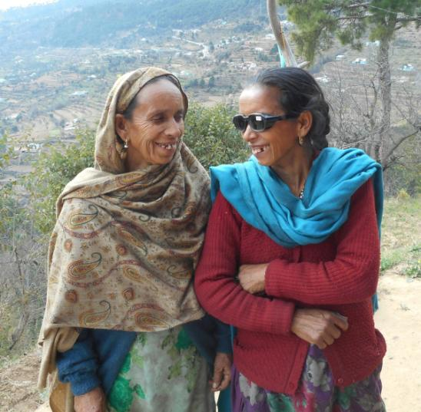
Thanks to you!
Because of donors
like you
this woman can see!
please donate at norfolkrotary.org
Notes:
Thanks so much for your support for Rotary and Operation Eyesight over the years! With your support, we can continue to make a huge difference in people’s lives! We would be very grateful if you were able to again support Operation Eyesight through our club. There are a number of ways you can do this – see our website for details or to make an on-line donation.

